Slide 1
PAYPULSE
Digital Payment Failure
and Refund Analytics System
Project Review Presentation
Presented by: THOTAKURA DURGA SRI

Slide 2
Problem Statement
Why payment failures and refunds need structured analysis
PAYMENT FAILURES
REFUND VISIBILITY
SCATTERED INFORMATION
Digital transactions may fail, remain pending, or be cancelled. Teams need a clear way to inspect transaction outcomes.
Refund requests can have different stages such as requested, processing, completed, or rejected.
Customer, merchant, gateway, payment method, transaction, and refund details are related and should be analysed together.
PROJECT FOCUS
Build a relational database that organises payment information and supports queries and summaries for transaction and refund analysis.

Slide 3
Project Objectives
01
Organise data
Maintain structured records for customers, merchants, gateways, methods, statuses, transactions and refunds.
02
Track outcomes
Identify successful, failed, pending, processing and cancelled transactions.
03
Analyse refunds
Store refund amounts, request/processing dates and refund status.
04
Support reporting
Use SQL queries, views, indexes and stored procedures for reusable analysis.
05
Maintain history
Use a trigger to record transaction status changes in a history table.

Slide 4
Proposed System & Workflow
How the database entities work together
MASTER DATA
TRANSACTIONS
REFUNDS
ANALYTICS
Customers • Merchants
Gateways • Methods • Statuses
Each transaction links to
customer, merchant, gateway,
method and status
Refund record references
a transaction and stores
amount, dates and status
Queries, views and procedures
summarise transaction and
refund information
→
→
→
Status changes are captured in TRANSACTION_STATUS_HISTORY by a database trigger.

Slide 5
Technology Stack
Tools used to build and manage the database project
MYSQL SERVER 8.0
MYSQL WORKBENCH
ERDPLUS
Relational database engine used to store PayPulse tables and enforce relationships.
SQL development environment used to create, execute and inspect database objects.
Used to prepare the ER diagram and represent entities, attributes and relationships.
CORE LANGUAGE: SQL (MYSQL SYNTAX)
The project is implemented as a relational database; no separate application interface is claimed in this presentation.

Slide 6
Database Design – 8 Tables
Logical grouping of PayPulse database entities
MASTER TABLES
TRANSACTION TABLE
SUPPORTING TABLES
CUSTOMERS
MERCHANTS
PAYMENT_GATEWAYS
PAYMENT_METHODS
TRANSACTION_STATUSES
TRANSACTIONS
Central record connecting customer,
merchant, gateway, method and status.
REFUNDS
Stores refund records linked to transactions.
TRANSACTION_STATUS_HISTORY
Stores status-change history.
Primary keys uniquely identify records; foreign keys connect related tables.

Slide 7
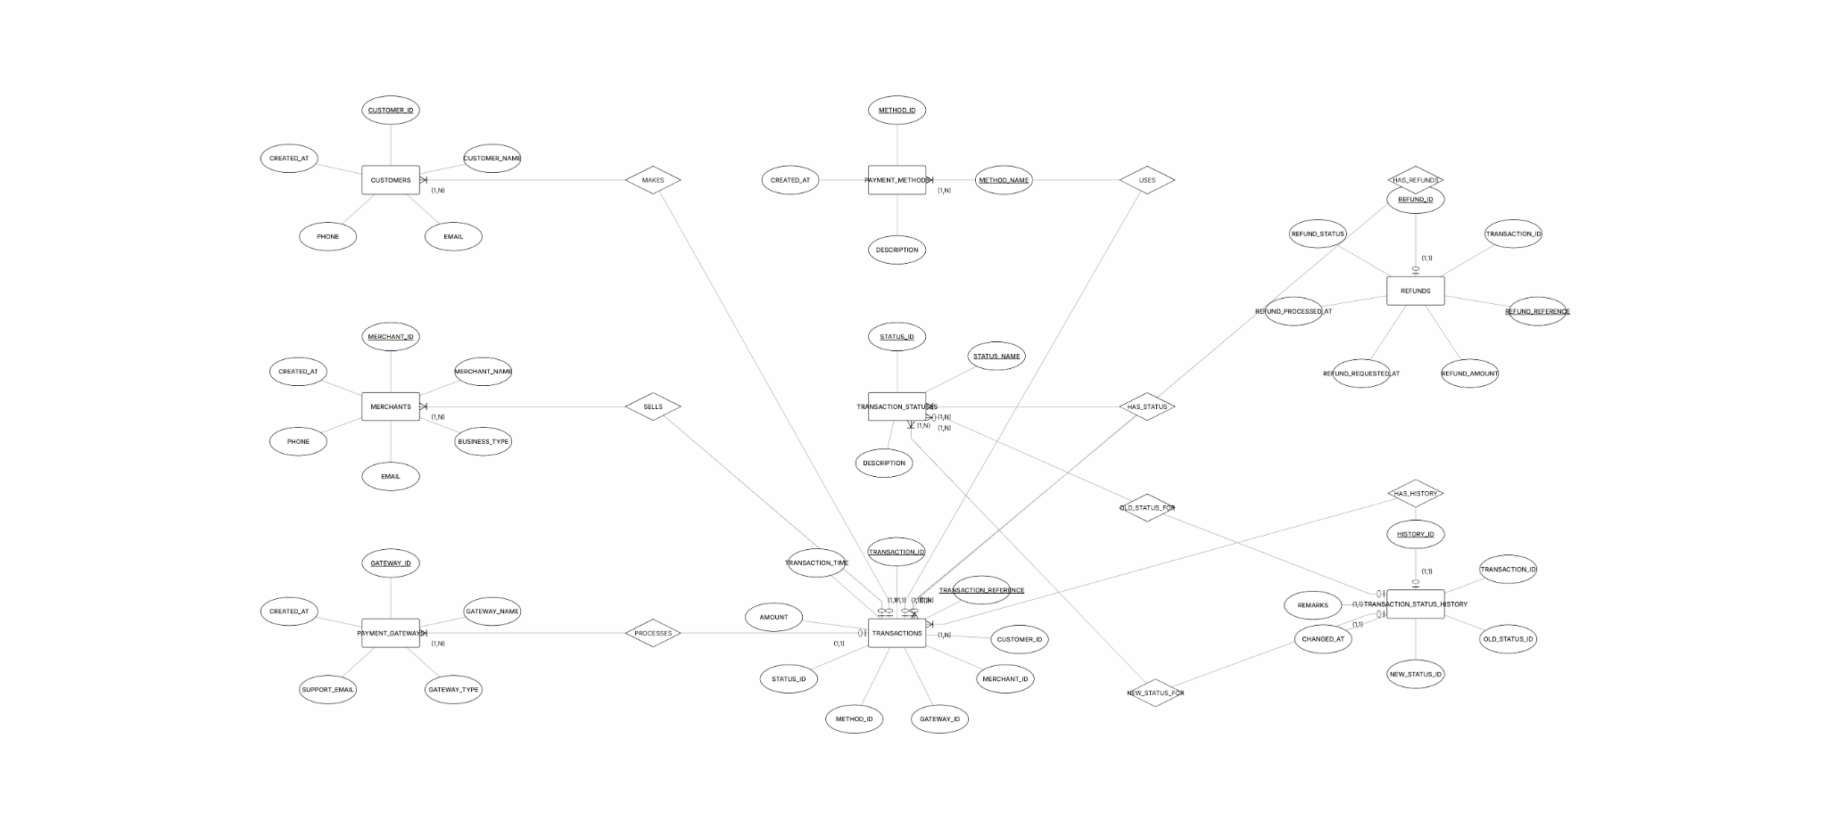
Entity Relationship Diagram
Original ER diagram created in ERDPlus

Slide 8
Key Tables & Relationships
Summary of the relational structure
TRANSACTIONS
REFUNDS
Contains transaction ID/reference, customer, merchant, gateway, method and status IDs, amount and transaction time.
References TRANSACTIONS and stores refund reference, amount, requested/processed dates and refund status.
TRANSACTION_STATUS_HISTORY
MASTER TABLES
References TRANSACTIONS and stores old status, new status, change timestamp and remarks.
Provide customer, merchant, gateway, payment-method and transaction-status details referenced by TRANSACTIONS.

Slide 9
Sample Data, Constraints & Indexes
Data populated for demonstration and query testing
SAMPLE DATA
TRANSACTION DATA
DATA INTEGRITY
10 customers
5 merchants
3 payment gateways
4 payment methods
5 transaction statuses
30 sample transactions
10 refund records
30 initial status-history records
Primary and foreign keys
Unique references/emails
Positive amount checks
Allowed refund-status values
INDEXES CREATED
IDX_TRANSACTIONS_STATUS_TIME • IDX_TRANSACTIONS_MERCHANT_TIME
IDX_REFUNDS_TRANSACTION_STATUS

Slide 10
Views & Stored Procedures
Reusable database objects for reporting
VIEWS
STORED PROCEDURES
VW_FAILED_TRANSACTIONS
Shows failed transaction details with related customer, merchant, gateway and payment-method information.
VW_REFUND_ANALYTICS
Combines refund, transaction, customer and merchant information.
VW_MERCHANT_PAYMENT_SUMMARY
Summarises transaction counts, success/failure counts and amount by merchant.
SP_GET_TRANSACTIONS_BY_STATUS
Accepts a status name and returns matching transactions.
SP_CUSTOMER_TRANSACTION_SUMMARY
Accepts a customer ID and returns a transaction summary.
SP_MERCHANT_TRANSACTION_SUMMARY
Accepts a merchant ID and returns a merchant summary.

Slide 11
SQL Query Bank & Trigger
21 numbered queries across three levels plus additional analysis
LEVEL 1 | Q1–Q4
LEVEL 2 | Q5–Q8
LEVEL 3 | Q9–Q11
Basic SELECT queries
Retrieve failed, successful and pending transactions.
Grouping, aggregate functions, subqueries and merchant summaries.
Advanced aggregation and filtering using HAVING and joins.
NEW QUERIES | Q12–Q21
TRIGGER
Customer details, date/string functions, averages, min/max, total amounts and EXISTS.
TRG_TRANSACTION_STATUS_UPDATE runs AFTER UPDATE on TRANSACTIONS and logs changed statuses in TRANSACTION_STATUS_HISTORY.

Slide 12
Conclusion & Future Scope
WHAT THE PROJECT DELIVERS
FUTURE ENHANCEMENTS
A structured relational database for digital payment transaction and refund records, with reusable reporting objects and status-history tracking.
Connect a payment application/API, build a dashboard, add automated refund workflows, and analyse failure trends by gateway and payment method.
THANK YOU

